Slide 1
The GLOBE Program in Nepal
GLOBE Asia Pacific Regional Meeting
May21-23, 2019
Yogendra Chitrakar
yogendra@ecca.org.np
www.ecca.org.np

Slide 2
ECCA Brief
Established in 1987 as a non profit, non political, non govt. org.
Pioneered the concept of children nature club (in Nepal) in1992
First NGO to establish a paper-recycling unit in 1994
Awards:
1991 and 2001 by Government of Nepal
1993, International Rolex Award (for ECCA’s unique methodology)
2005, Global Development Marketplace (for Solar Tuki), World Bank, Washington DC, USA
2007, Tech Museum Awards (category Economic Development) (for Solar Tuki), The Tech Museum of Innovation, California, USA
2008, Nepal Development Marketplace (for safe drinking water campaign)
2014, Nature Conservation Award, Nepal Academy of Science and Technology (NAST)

Slide 3
ECCA mission and methodology
ECCA shall be a Professional Volunteer Organization dedicated towards securing sound ecological future
ECCA shall support the development of conservation related entrepreneurship
Expert
Counsellor/Youth Training Camp
Information Flow /
Feedback
Youth
ECCA Camp
Children
Nature Club/school to school Program/Primary Environmental Care
Community

Slide 4
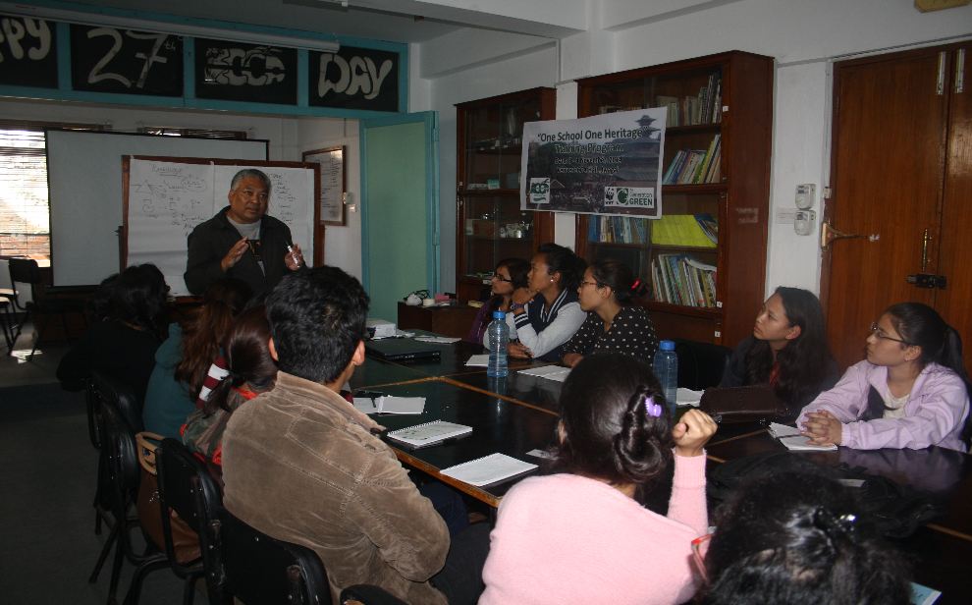
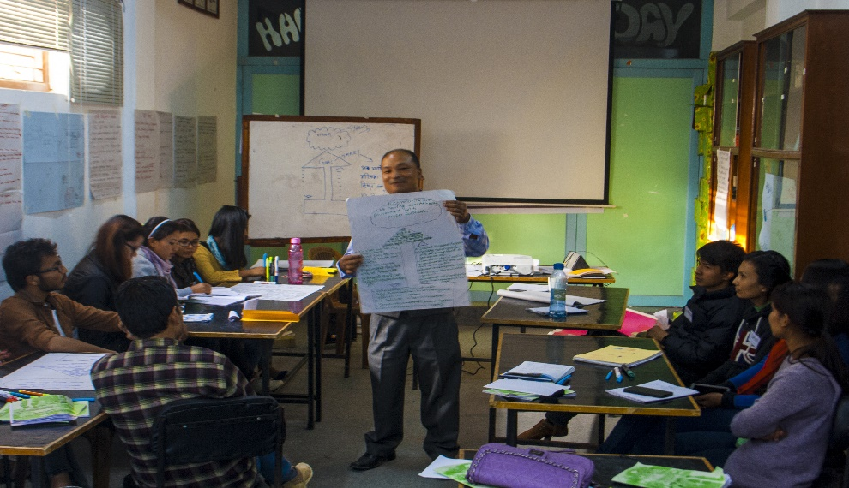
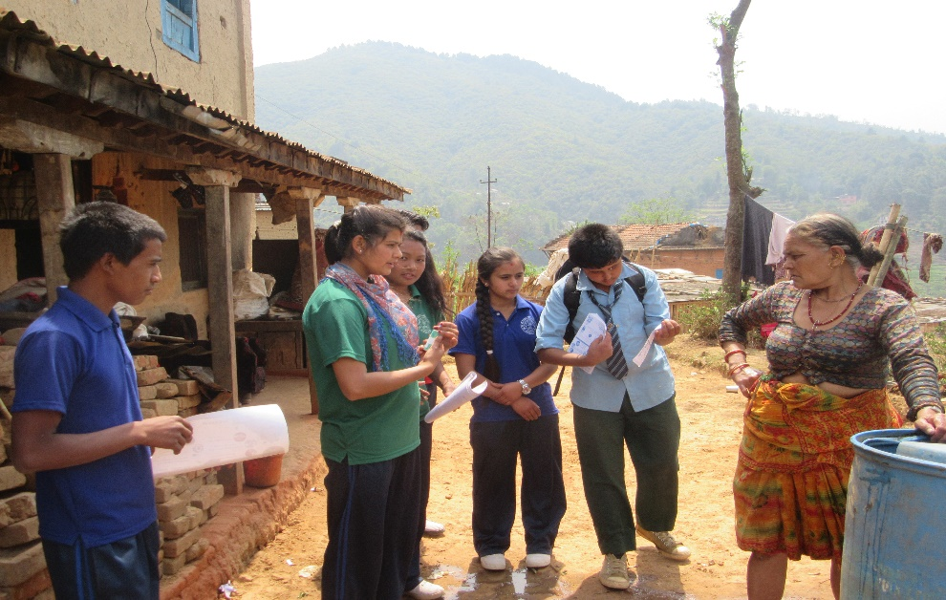
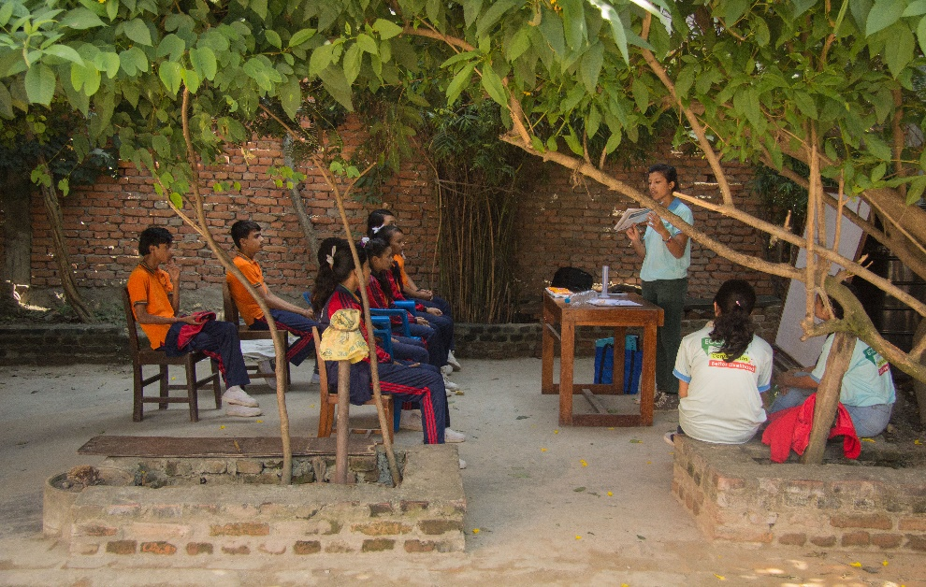
Approach

Slide 5
ECCA Footprints

Slide 6
Field of Work
Environment, Climate Change, Disaster Management, Natural Resource Management, Nutrition, Food Security, Enhancing Livelihood
Education for Sustainable Development and School Environment Improvement
Child rights and development
Appropriate Technology / Renewable Energy
Water, Sanitation and Hygiene (WASH)
Redevelopment and Reconstruction

Slide 7
GLOBE Current Status
Launched : March 3, 2000
Cooperating Organizations
ECCA – Country Coordinator
Government & Private Schools
Participation
25 Schools
Current Focus on: 4 schools of East Nepal and 5 schools within the valley
Funding Status
ECCA Self Funding and GLOBE for CMT
Protocols Implemented
Atmosphere – training and data entry
Hydrology – training and data entry
Land coverage only trainings
Mosquito

Slide 8
Review of GLOBE 2018
Planning | Accomplished
Increase youth participation in school based GLOBE programs | 31 College students were provided GLOBE trainings and mobilized in schools
Initiate interest regarding GLOBE among more schools and teachers | 2 Orientations for 7 schools’ 20 teachers and Principals 15 students
Conduct 3 Country Based Trainings in Mosquito protocol | 75 participants – 1 CMT in Jhapa and 2 in Kathmandu
Conduct GLOBE Learning Expedition 2018 with various partners | 44 participants from Thailand, Oman, Taiwan, India, Nepal
Conduct 5 LMT | Conducted 1 LMT of 25 participants in 1 school and shared with all students through trained teachers and students.

Slide 9
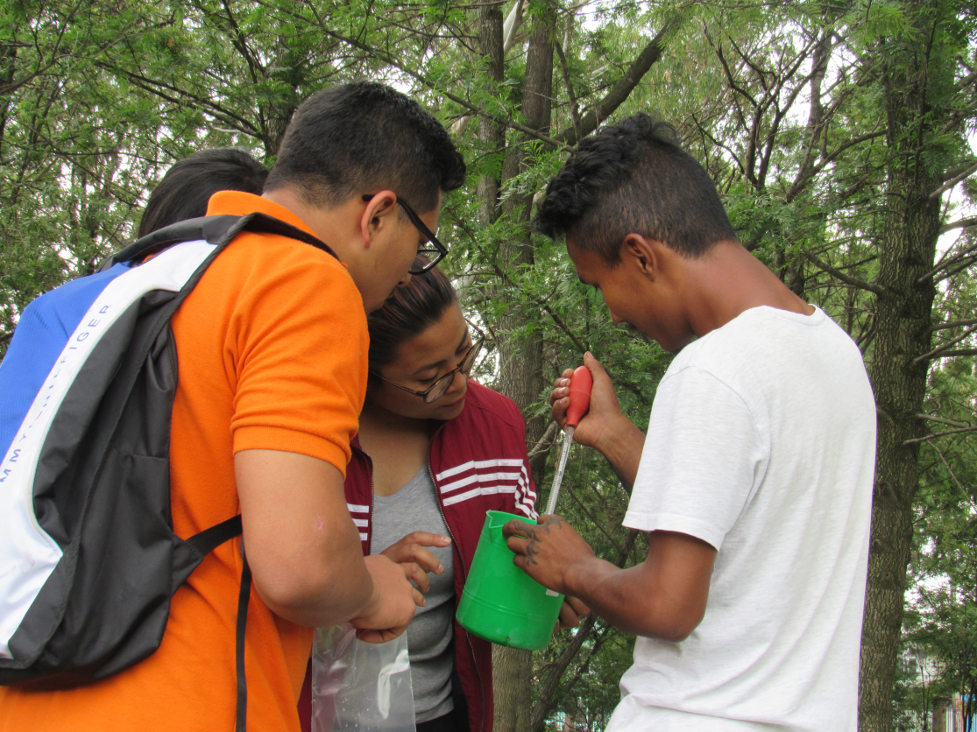
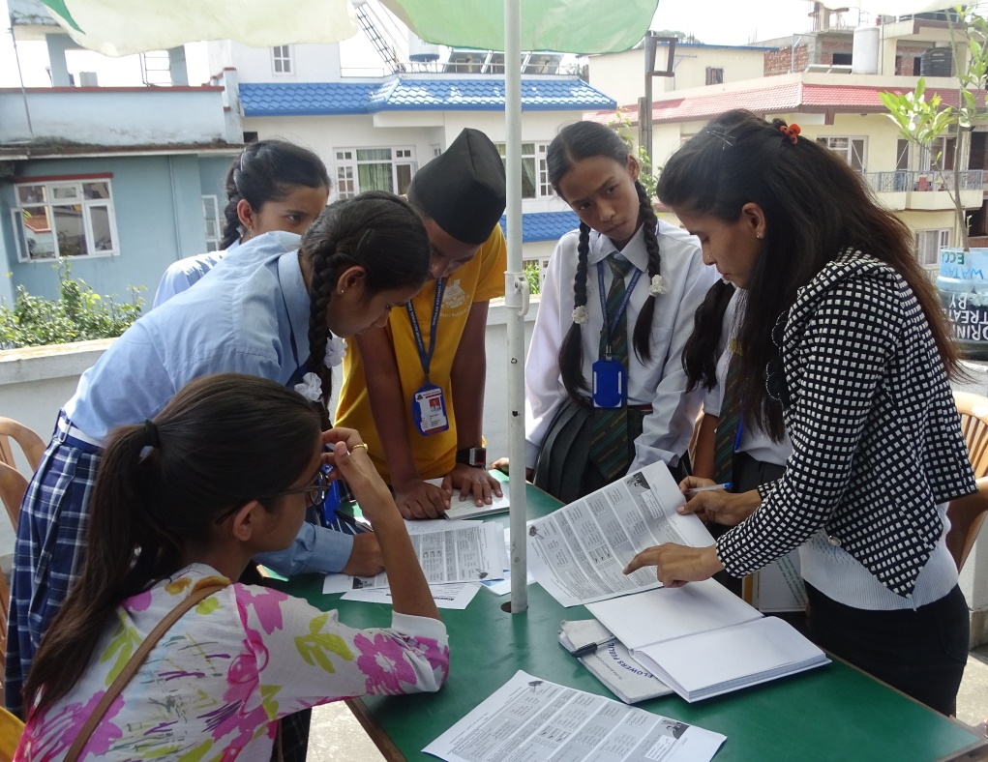
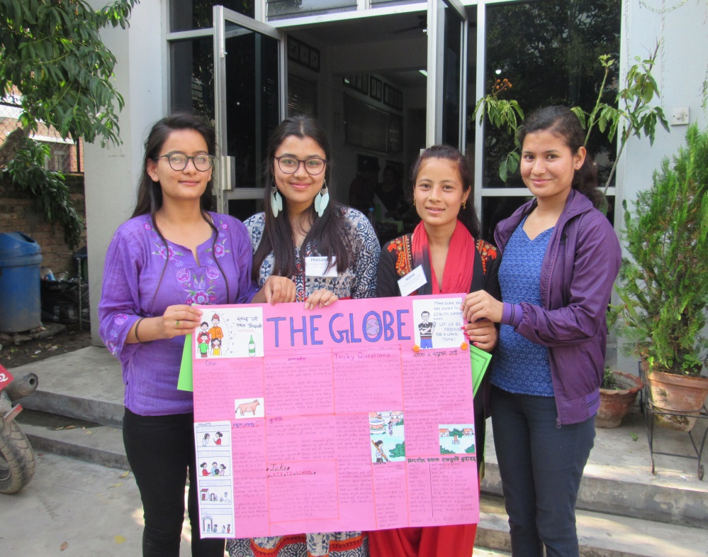
GLOBE Activities 2018
GLOBE integration in ECCA’s Youth Training
GLOBE program was introduced in one Counselor Training Camp conducted by ECCA in June 4-6, 2018.
23 Nepalese youth took the training
Focused topics: WASH, school environment, Climate change, theoretical discussions and practical on GLOBE Protocols (atmosphere, hydrology, land cover, mosquito)

Slide 10
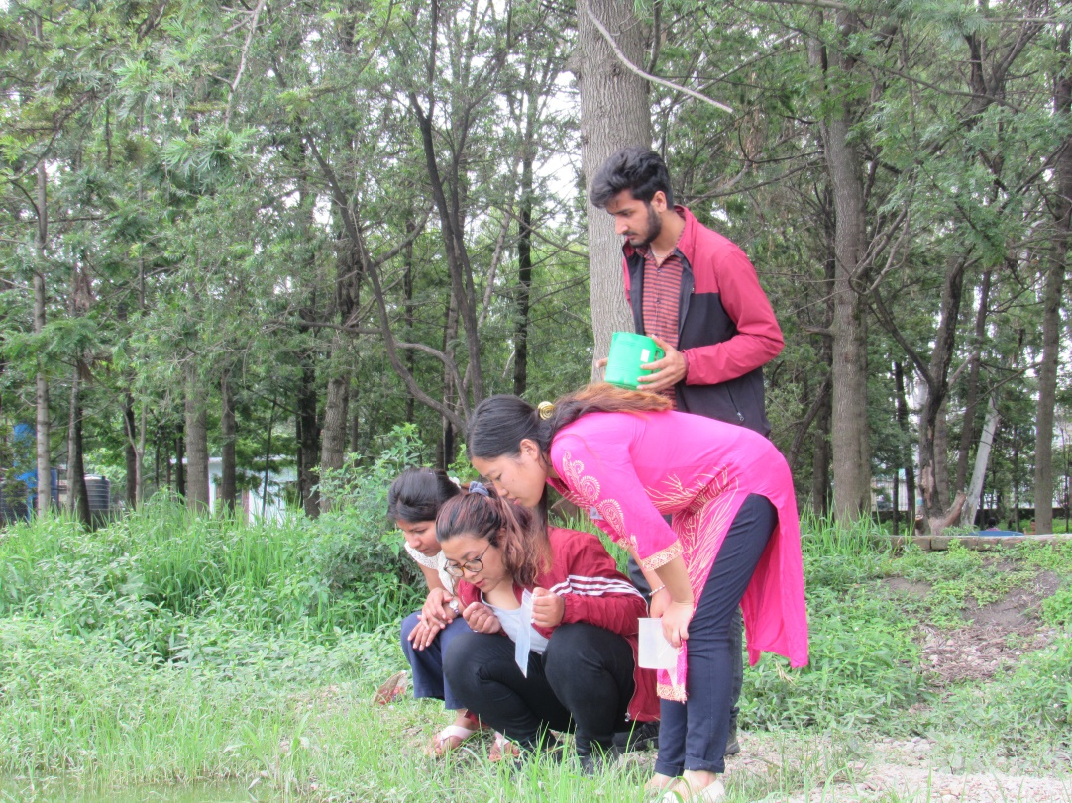
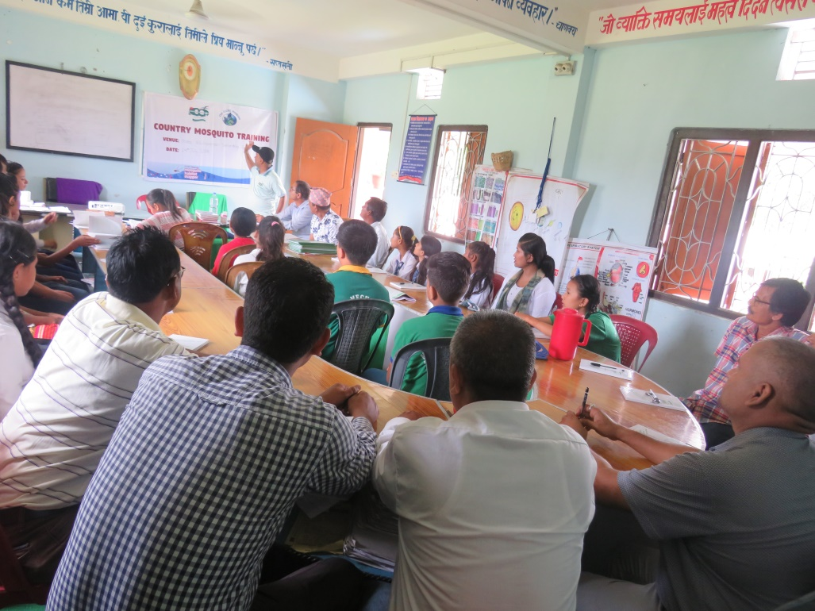
GLOBE Activities 2018
3 CMT was conducted in Jhapa and Kathmandu for 75 participants

Slide 11
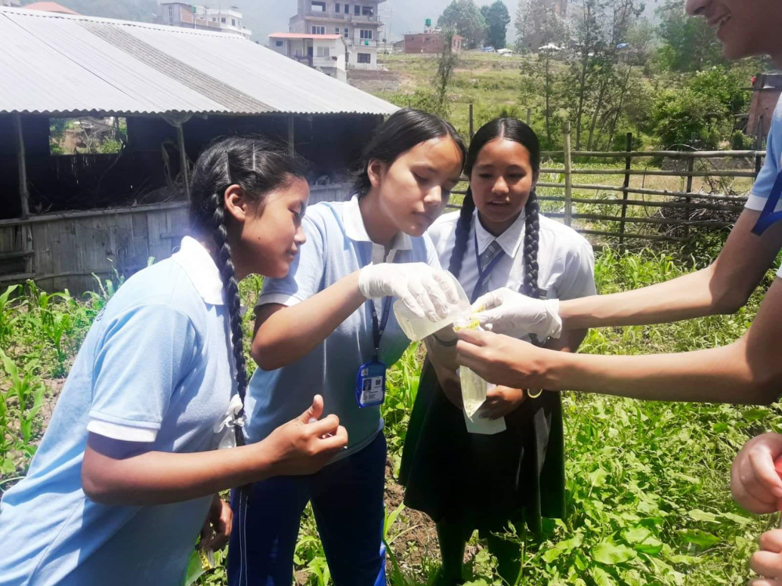
Local Mosquito Training
Out of 5 LMT, one LMT is conducted for 23 students, 2 teachers and 1 health assistant Crescent Academy in Godavari

Slide 12
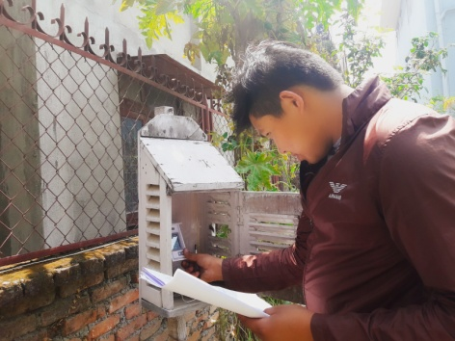
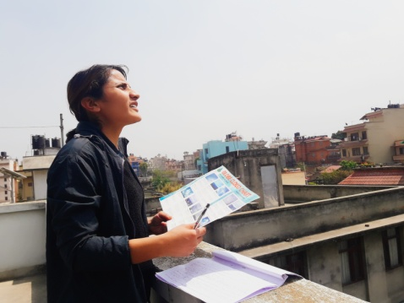
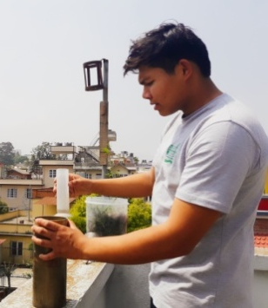
GLOBE Activities 2018
Youth mobilization for regular data entry from ECCA office

Slide 13
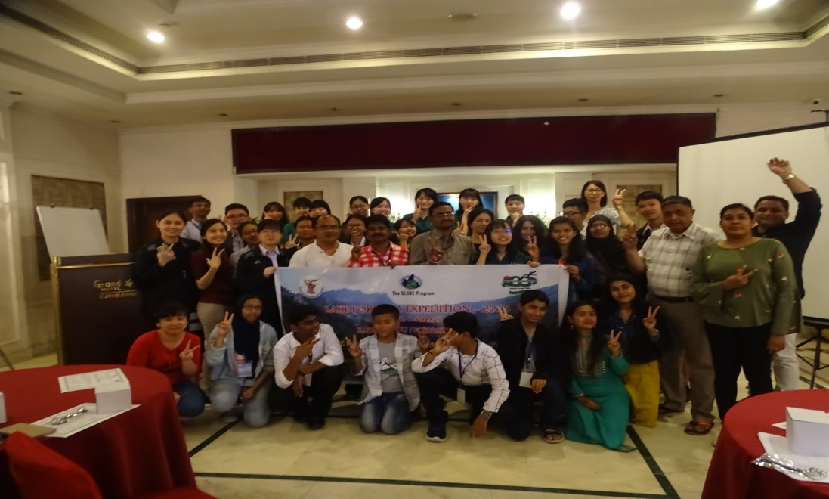
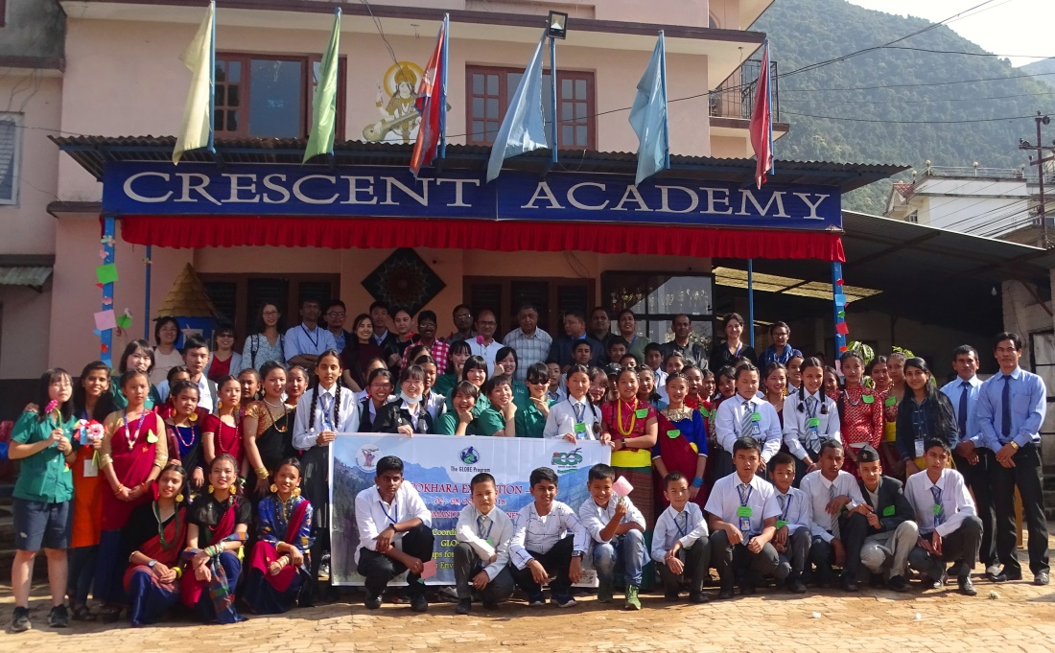
GLOBE Activities 2018
GLOBE Learning Expedition 2018
Environmental Camps for Conservation Awareness (ECCA) in coordination with Indian Environmental Society conducted GLOBE Learning Expedition from October 2-8, 2018
44 participants from 5 countries (Oman, Thailand, Taiwan, Nepal and India) participated. Students, teachers, country coordinators and trainers received an opportunity to facilitate GLOBE protocols together in Pokhara, the City of Lakes.

Slide 14
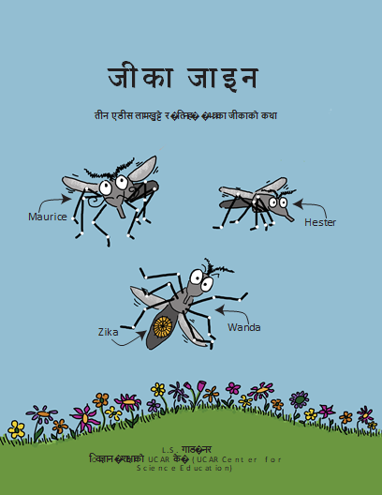
Zika Zine The story of the Aedes mosquitoes and the zika within them
Nepali version edition
Coordinating with
Emily Snode-Brenneman
UCAR Center for Science Education

Slide 15
The Way Forward
Support and facilitate LMT program
Increase the participation of Private Schools by developing programs regarding GLOBE protocols
Increase the no. of trainings for Students, Teachers and Youths on GLOBE Protocols
Organize orientation / interaction programs on GLOBE Program for Implementation for likeminded organizations
Organize sharing workshops for government representatives and stakeholders
Integrate GLOBE Activities in various ongoing programs and new proposals
Develop monitoring mechanism for consistent data entry in GLOBE Website

Slide 16
To Connect …. And for visibility
/ECCA.Nepal
/EccaNepal
eccablogs.wordpress.com
/EccaNepal

Slide 17
Thank you and welcome in GLOBE Phewa lake Expedition 2019

